Slide 1


Prathmesh Pandey

Slide 2
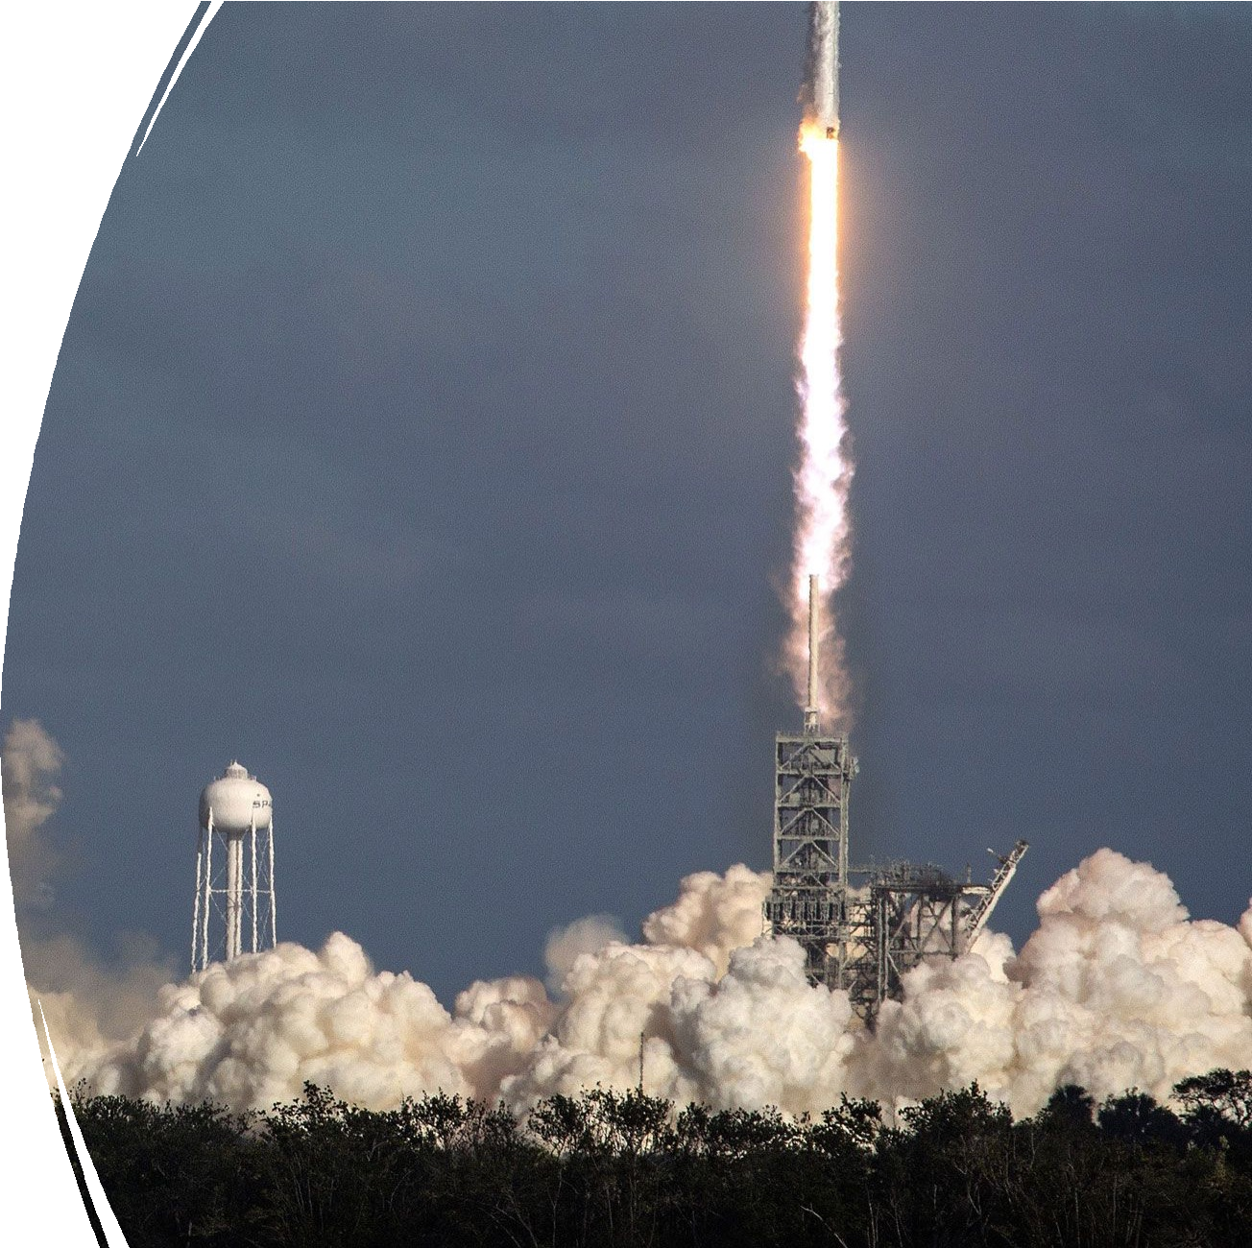
Outline
Executive Summary
Introduction
Methodology
Results
Conclusion
Appendix
2

Slide 3





Executive Summary
Summary of methodologies
Data was collected from the SpaceX public API
Utilized SQL queries and various data visualizations to uncover insights within the dataset
Use Grid Search method to find the best Machine Learning Model to predict the classification of next landing
Summary of all results
Exploratory Data Analysis result
Predictive Analytics result
3

Slide 4
Introduction
Project background and context
SpaceX advertises Falcon 9 rocket launches on its website with a cost of 62 million dollars; other providers cost upward of 165 million dollars each, much of the savings is because SpaceX can reuse the first stage.
Therefore, if we can determine if the first stage will land, we can determine the cost of a launch. This information can be used if an alternate company wants to bid against SpaceX for a rocket launch.
Problems to Research
Can the historical launch data be used to predict the success of a new launch's first stage landing?
What operational conditions are necessary to guarantee a successful landing program?
4

Slide 5

Section 1
5

Slide 6
Methodology
Executive Summary
Data collection methodology:
Data was collected using SpaceX API and web scraping from Wikipedia.
Perform data wrangling
Encoded using one-hot encoding.
Perform exploratory data analysis (EDA) using visualization and SQL
Perform interactive visual analytics using Folium and Plotly Dash
Perform predictive analysis using classification models
Using GridSearchCV to find best fit model.

Slide 7
Data Collection
To analyze the Falcon 9 rocket launches, data was gathered from multiple sources and processed accordingly:
SpaceX API
Web Scraping from Wikipedia

Slide 8
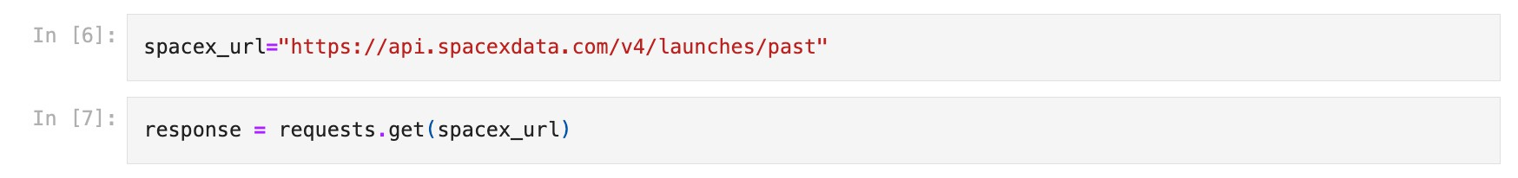
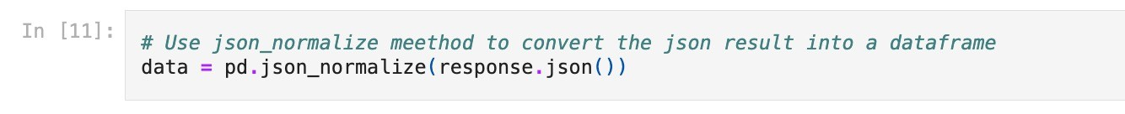
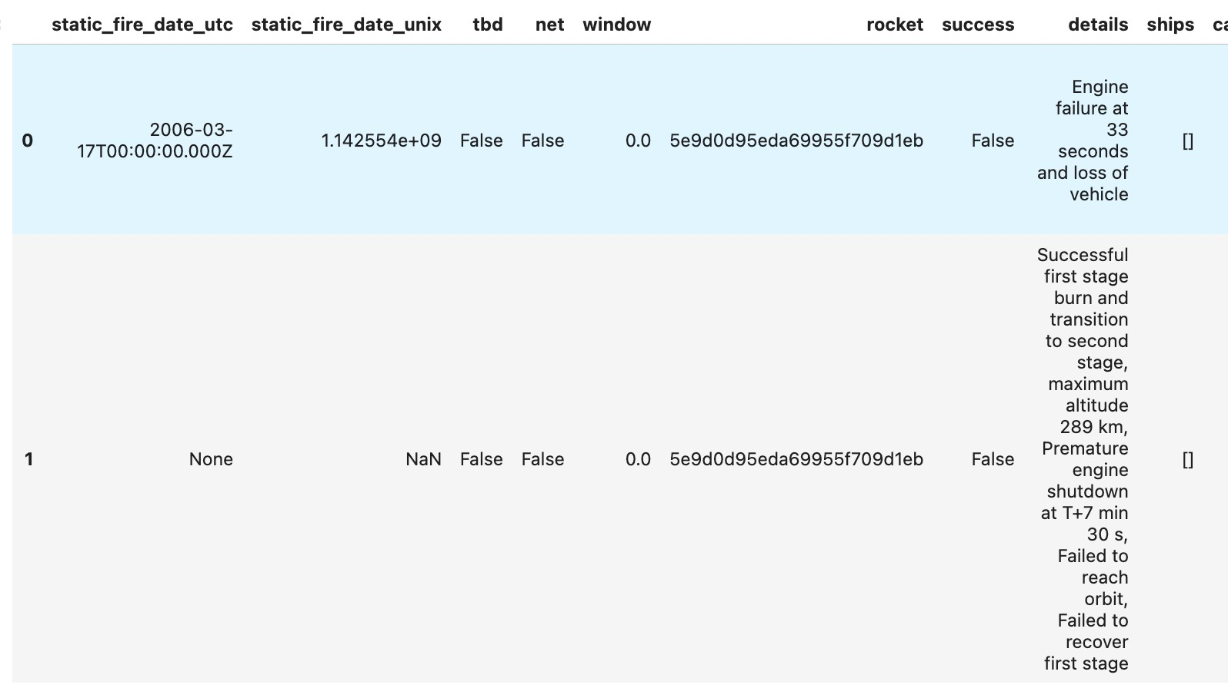
Data Collection – SpaceX API
SpaceX API:
The primary data source is the SpaceX API at https://api.spacexdata.com/v4/rockets/, filtered specifically for Falcon 9 launches.
Missing values in the dataset were replaced with the mean of their respective columns.
https://github.com/llouislouis/iBM_Data Science_Capstone_SPACE_X/blob/main/ Lab1_Data%20Collection%20API.ipynb

Slide 9
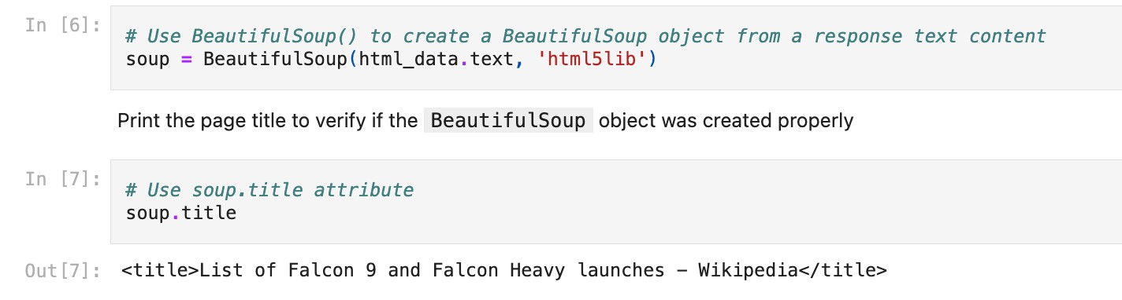
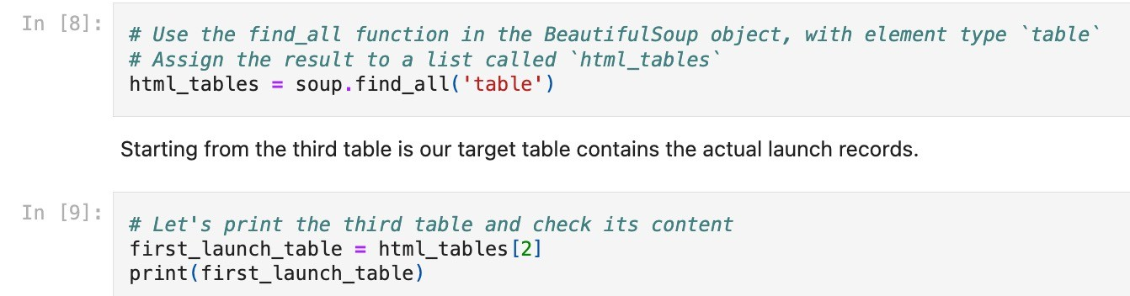
Data Collection - Scraping
Web Scraping from Wikipedia:
Additional data was scraped from Wikipedia using the URL https://en.wikipedia.org/w/index.php
?title=List_of_Falcon_9_and_Falcon_
Heavy_launches&oldid=1027686922
https://github.com/llouislouis/iBM_ DataScience_Capstone_SPACE_X/bl ob/main/Lab2_Data%20Collection
%20with%20Web%20Scraping.ipy
nb

Slide 10
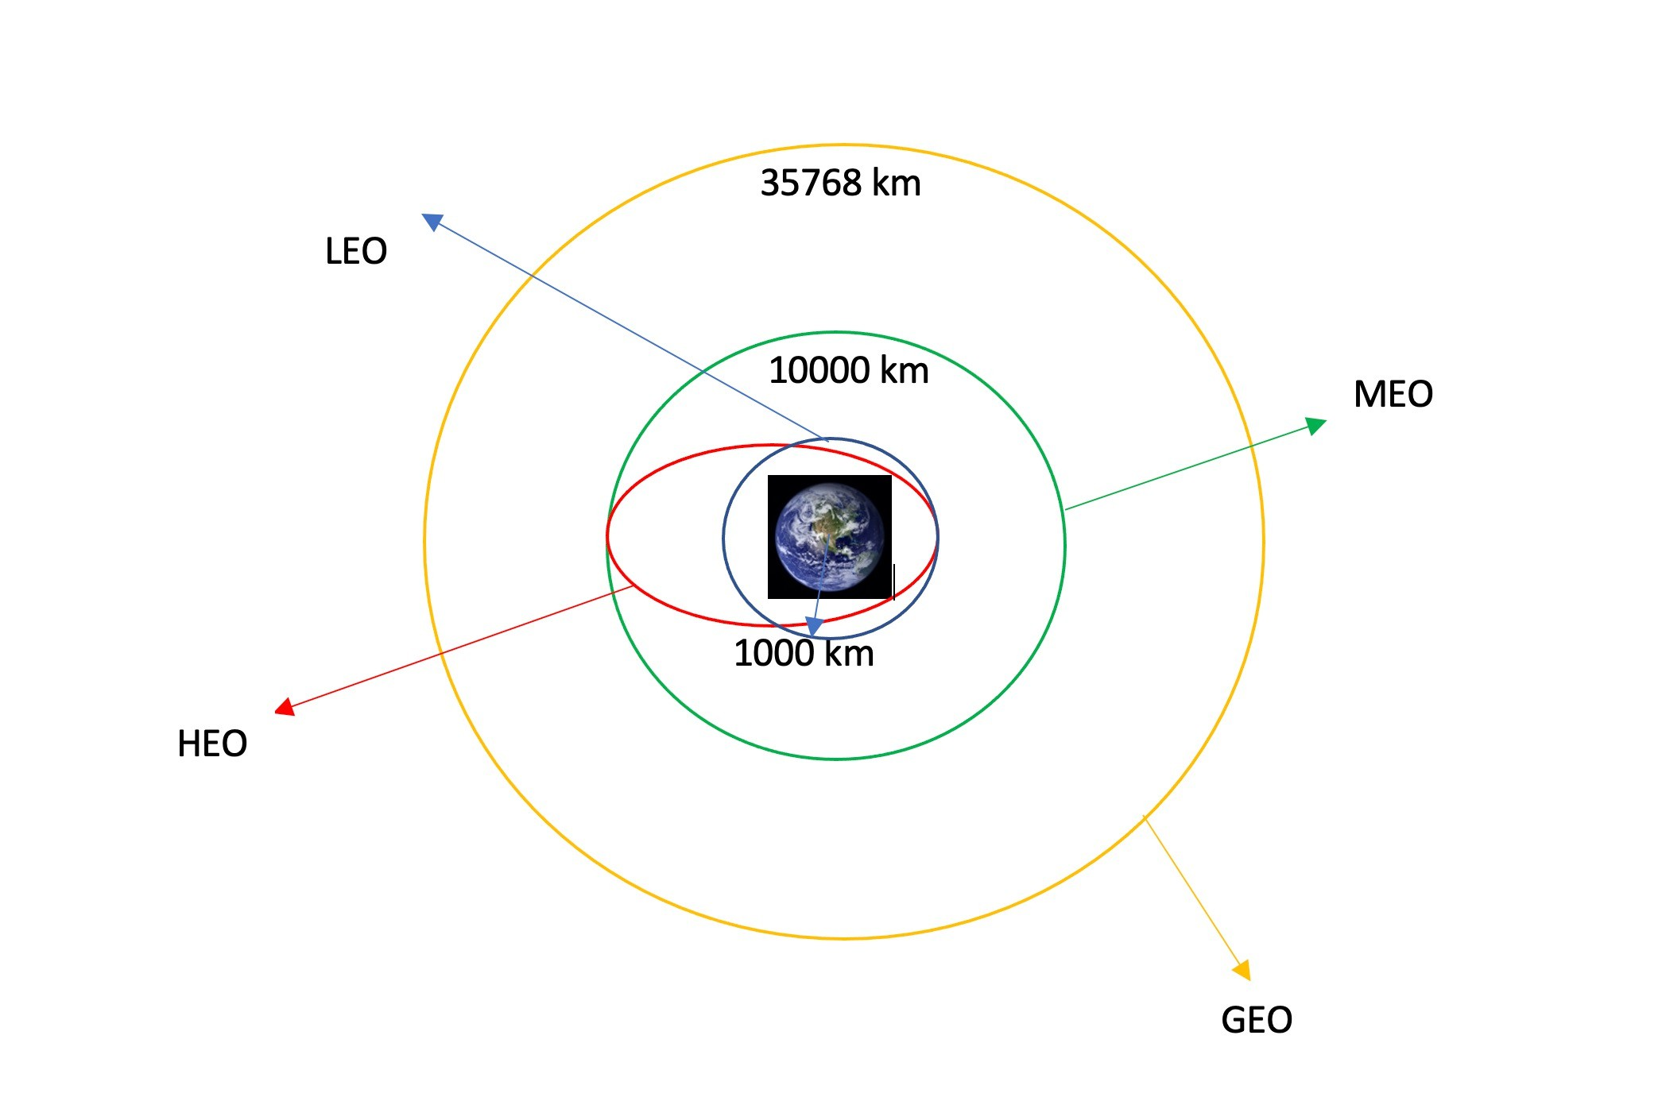
Data Wrangling
conducted exploratory data analysis to identify the training labels.
analyzed the number of launches at each site and examined the frequency and types of orbits
Derived the landing outcome labels from the outcome column and exported the results to a CSV file
https://github.com/llouislouis/iBM_DataScience_Capstone_SPACE_X/blob/main/Lab3_Data%20Wra ngling.ipynb
10
some common orbit types

Slide 11
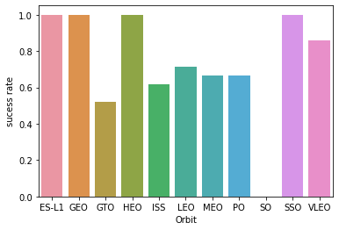
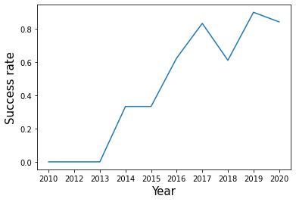
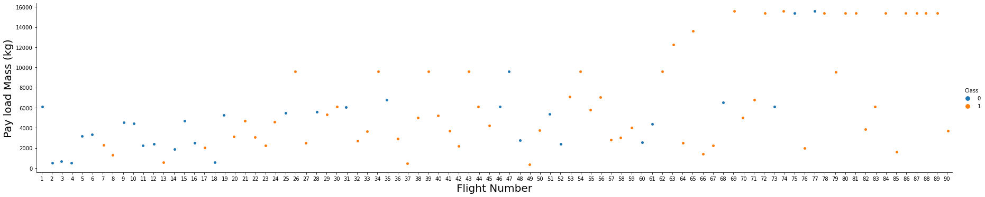
EDA with Data Visualization
The total success launches from each launch site
The correlation between payload mass and mission
outcome (success or failure) for each launch site
Trend by year
https://github.com/llouislouis/iBM_DataScience_Capsto
ne_SPACE_X/blob/main/Lab5_Data_visual.ipynb

Slide 12

EDA with SQL
Retrieve the names of the unique launch sites used in the space missions.
Identify the booster versions that have carried the maximum payload mass.
Count the total number of successful and failed mission outcomes.
List the names of the boosters that have successfully landed on a drone ship and have a payload mass within a specific range.
Rank the successful landing outcomes within a given date range in descending order.
https://github.com/llouislouis/iBM_DataScience_Capstone_SPACE_X/blob/main/Lab4_EDA%20with%20SQL.ipynb

Slide 13
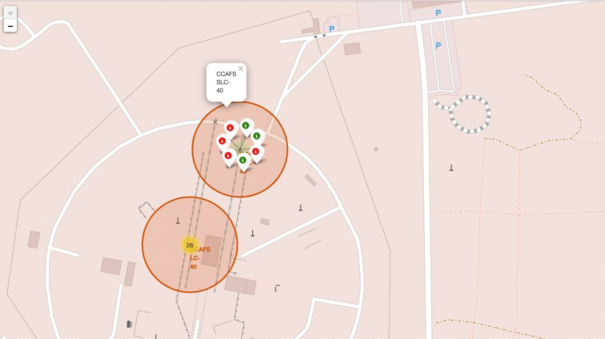
Build an Interactive Map with Folium
Summarize what map objects such as markers, circles, lines, etc. you created and added to a folium map
Markers were added for launch sites and for the NASA Johnson Space Center
Circles were added for the launch sites.
Lines were added to show the distance
https://github.com/llouislouis/iBM
_DataScience_Capstone_SPACE_X/ blob/main/Lab6_site_location_foli um.ipynb
13

Slide 14
Build a Dashboard with Plotly Dash
developed an interactive dashboard using Plotly Dash.
Created pie charts displaying the total number of launches by specific sites.
generated scatter plots illustrating the relationship between Outcome and Payload Mass (kg) for different booster versions.
https://github.com/llouislouis/iBM_DataScience_Capstone_SPACE_X/blob/main/d ash_app.py

Slide 15
Predictive Analysis (Classification)
Loaded and transformed data using numpy and pandas, then split into training and testing sets.
Built various machine learning models and tuned hyperparameters with GridSearchCV.
Identified the best-performing classification model.
https://github.com/llouislouis/iBM_DataScience_Capstone_SPACE_X/blob/mai n/Lab7_ML.ipynb

Slide 16
Results
Exploratory data analysis results
Interactive analytics demo in screenshots
Predictive analysis results

Slide 17

Section 2

Slide 18
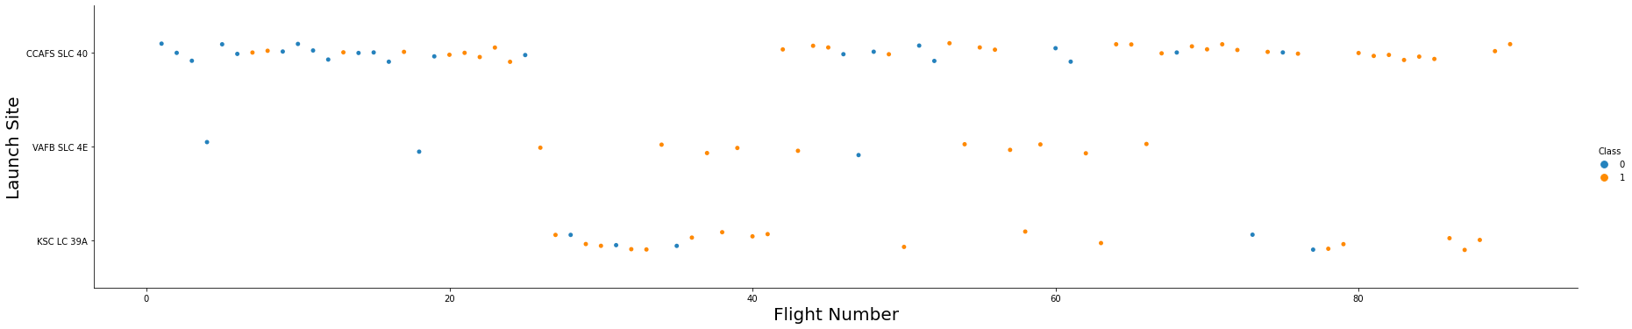
Flight Number vs. Launch Site
Explanation: We can see from the scatter plot that as flight number increases, there are more successful first stage landing. With small flight numbers, launches happens more in the site CCAFS SLC 40 and with much lower success rate. Although there are less launches in VAFB SLC 4E and KSC LC 39A, higher success rate can be seen in these two sites.

Slide 19
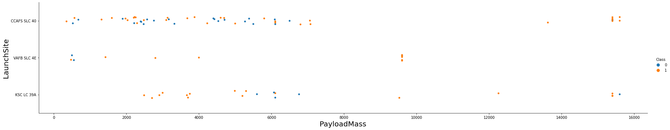
Payload vs. Launch Site
Explanation: With higher Payload the success rate is much higher. And in KSC LC39A launchsite we can see much higher success rate with low Payload whereas this rate is mucher lower in CCAFS SLC 40 launchsite. Besides, there no rockets launched in VAFB-SLC for Payload greater than 10000. Furthermore, with Payload more than 9500, we can see very high success rate overall.

Slide 20
Success Rate vs. Orbit Type
From the Bar Plot we can see for Orbit type ES-L1, GEO, HEO, and SSO have the highest success rate, which is 100%. And we also find in SO orbit, the rate is zero.

Slide 21
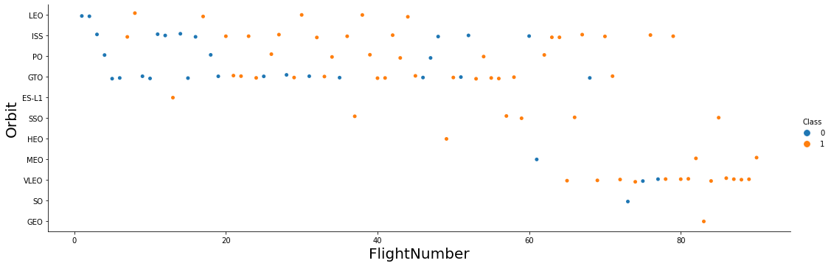
Flight Number vs. Orbit Type
•
Show a scatter point of
Flight number vs. Orbit type
Show the screenshot of the scatter plot with explanations
•
Explanation: In ES-L1, GEO, HEO, and SSO orbits, all launches are successful. There is clear relationship between flight number and success rate in LEO orbit since as flightnumber increases, the success rate increases. In contrast, there is no such obvious relationship in GTO orbit.

Slide 22
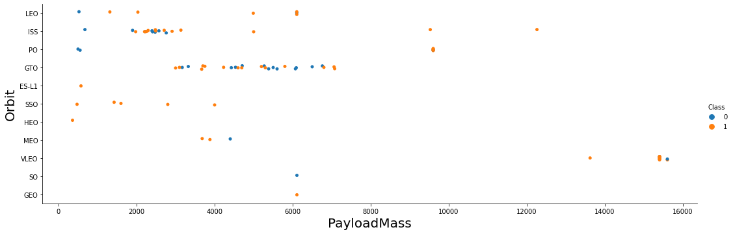
Payload vs. Orbit Type
Explanation: With heavy payloads the successful landing or positive landing rate are more for Polar,LEO and ISS.

Slide 23
Launch Success Yearly Trend
Explanation: The observe show that the success rate since 2013 kept increasing till 2020

Slide 24
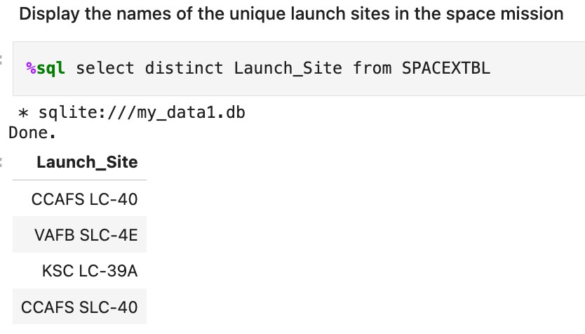
All Launch Site Names
Utilized the key word DISTINCT to show only unique launch sites from the SpaceX data.

Slide 25
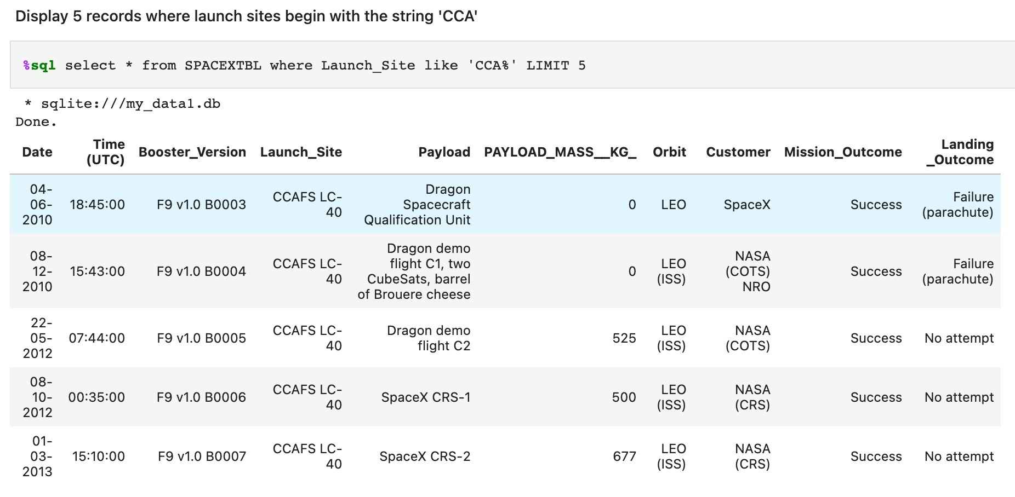
Launch Site Names Begin with 'CCA'
Explanation: these 5 launches happened in LEO orbit, and four of them were from customer NASA.

Slide 26
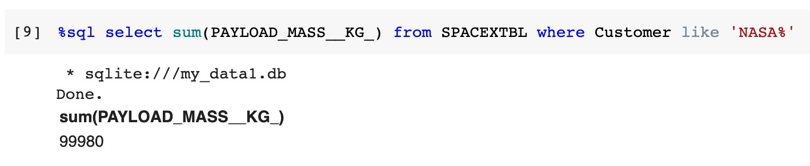
Total Payload Mass
Explanation: The total payload carried by boosters from NASA is 99980.

Slide 27
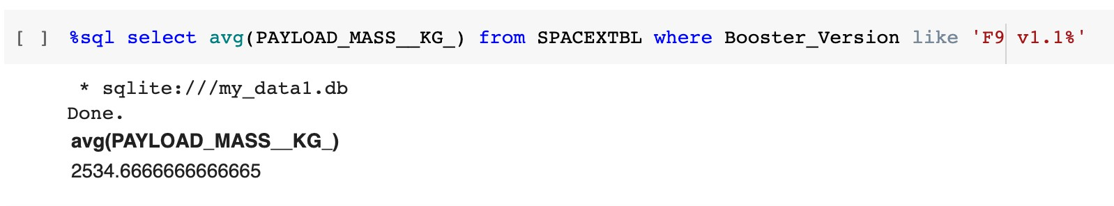
Average Payload Mass by F9 v1.1
Explanation: the average payload mass carried by booster version F9 v1.1 is
2534.67.

Slide 28
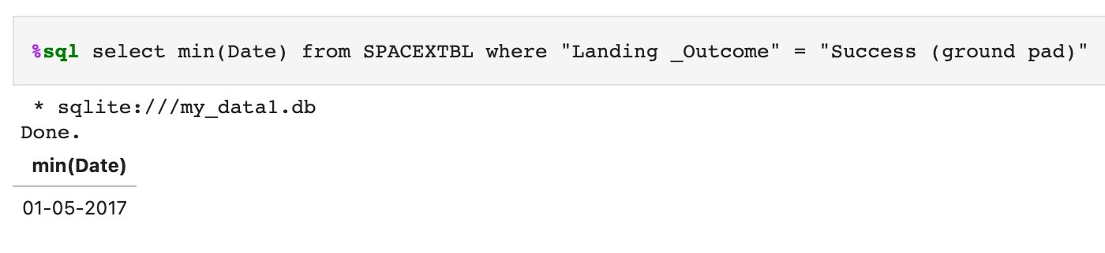
First Successful Ground Landing Date
Explanation: the first successful landing outcome on ground pad is 01-05-2017.

Slide 29
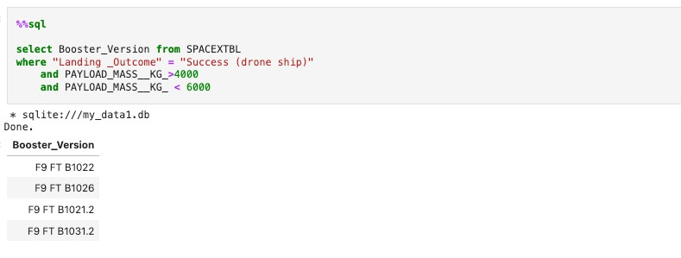
Successful Drone Ship Landing with Payload between 4000 and 6000
Explanation: names of the boosters which have success in drone ship and have payload mass greater than 4000 but less than 6000

Slide 30
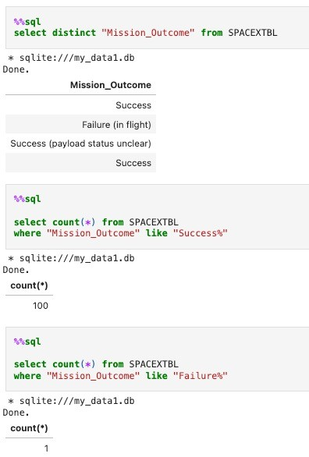
Total Number of Successful and Failure Mission Outcomes
Explanation:
the total number of successful
mission outcomes is 100
the total number of failure mission outcomes is 1

Slide 31
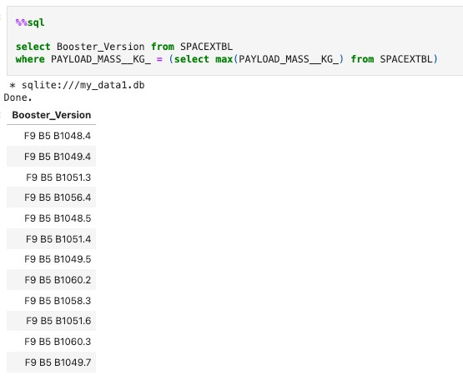
Boosters Carried Maximum Payload
Names of the booster which have carried the maximum payload mass

Slide 32
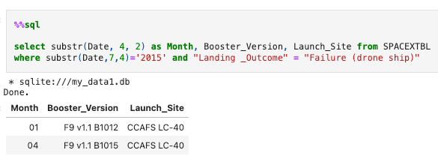
2015 Launch Records
List the records which will display the month names, failure landing outcomes in drone ship ,booster versions, launch site for the months in year 2015.

Slide 33
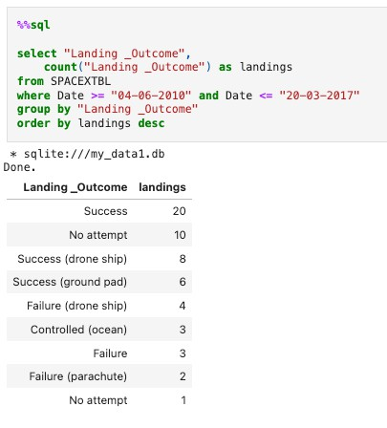
Rank Landing Outcomes Between 2010-06-04 and 2017-03-20
Rank the count of successful landing outcomes between the date 04-06-2010 and 20-03-2017 in descending order.

Slide 34

Section 3

Slide 35
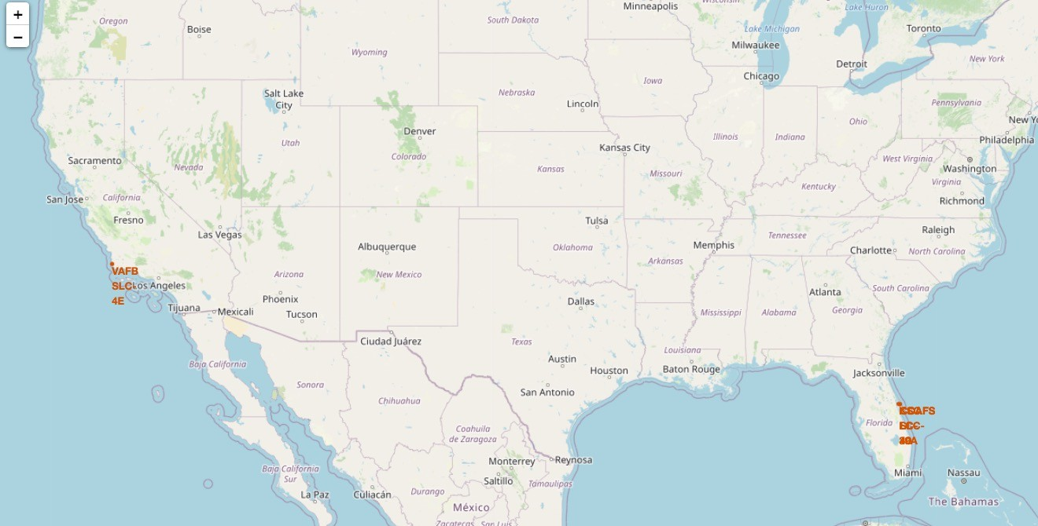
<Folium Map Screenshot 1>
The SpaceX launch sites are show in the USA coasts.
35

Slide 36
<Folium Map Screenshot 2>
The succeeded launches and failed launches for each site on map
36

Slide 37
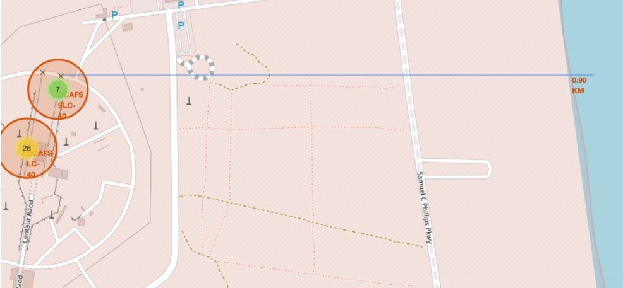
<Folium Map Screenshot 3>
Able to proximities a distance by line between a launch site to its closest city, railway, highway, etc.
37

Slide 38

Section 4

Slide 39
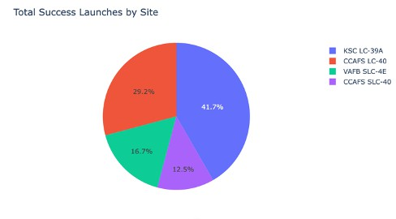
Pie chart showing the success percentage achieved by each launch site
Total Success Launches for All Sites is
CCAFS LC-40: 29.2%
VAFB SLC-4E: 16.7%
KSC LC-39A: 41.7%
CCAFS SLC-40: 12.5%

Slide 40
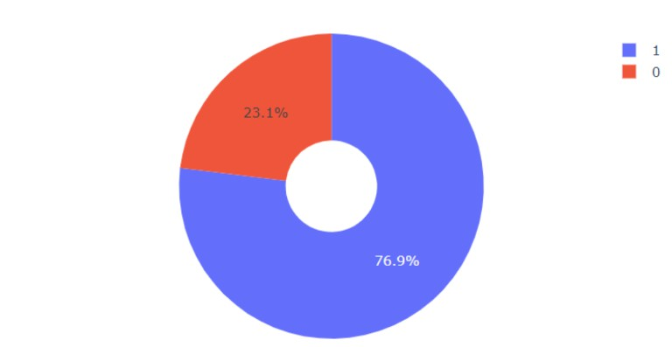
Pie chart showing the Launch site with the highest launch success ratio

Slide 41
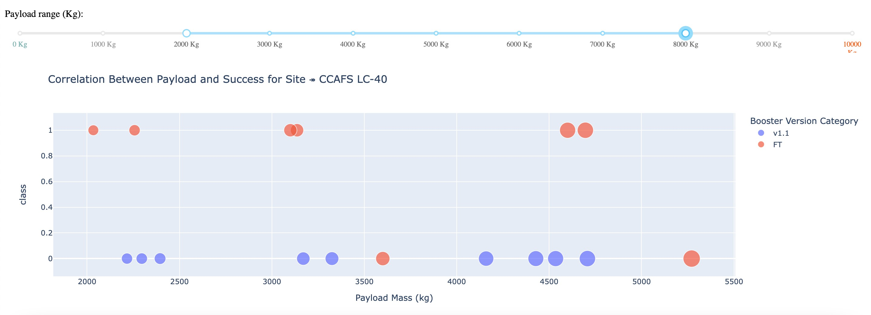
Payload vs. Launch Outcome

Slide 42

Section 5

Slide 43
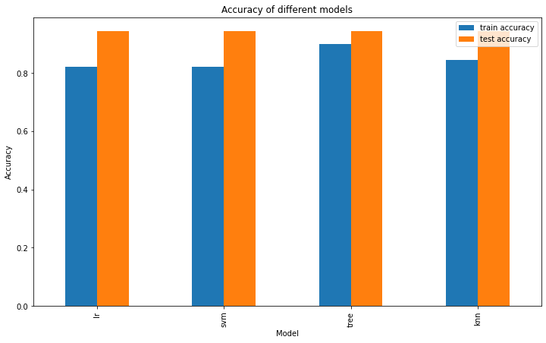
Classification Accuracy

Slide 44
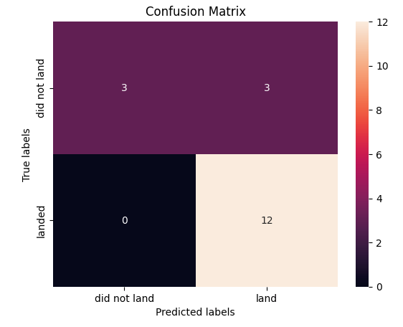
Confusion Matrix

Slide 45
Conclusions
We trained four models using GridSearchCV, with the Decision Tree model performing best on the test dataset, though it may have issues with false positives affecting bid estimations for rocket launches.
The dataset comprises 90 rows and 83 columns, split 80/20 into 72 training rows and 18 testing rows.
Key findings includes higher flight amounts at a launch site correlate with greater success rates; launch success rates increased from 2013 to 2020; orbits ES-L1, GEO, HEO, SSO, and VLEO had the highest success rates; and KSC LC-39A had the most successful launches.
The project aimed to predict Falcon 9 first stage landing outcomes to determine launch costs, with features like payload mass and orbit type influencing mission outcomes; the Decision Tree classifier was the best predictive model among those tested.

Slide 46


